Slide 1
Are Tactile Switches better for typing compared to Linear
Switches?
By: Wilson Leung and Alexander Cai
Notes:
Alex

Slide 2
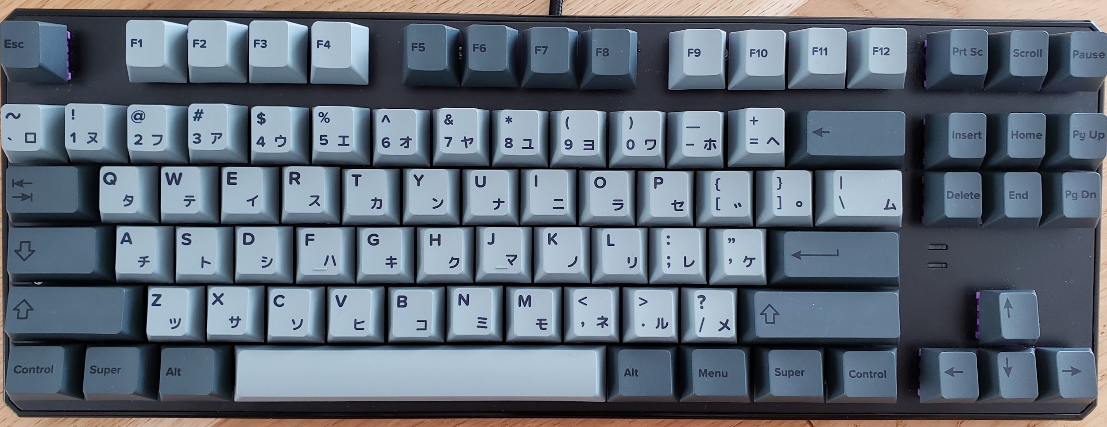

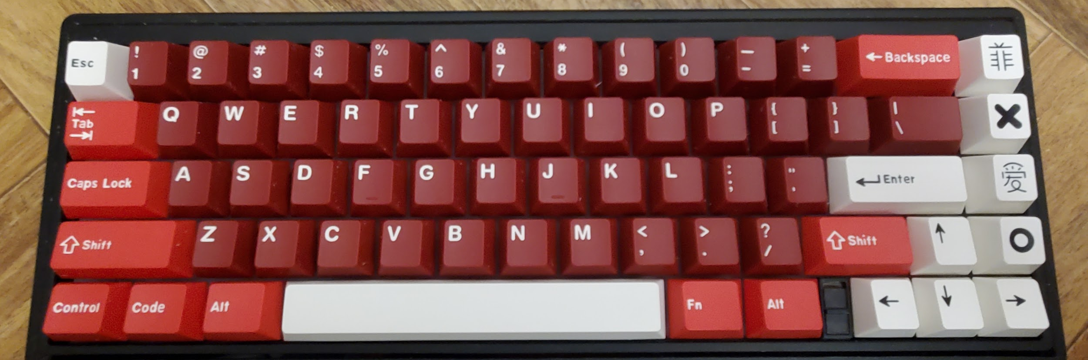
Introduction:
Tactile switches are targeted to consumers as typing enthusiast switches, but we want to figure out if people can type faster on Tactile switches compared to linear ones.
We chose this because we want to see on which keyboard switch do people type better on, and because we are both keyboard enthusiasts.
We will analyze our data by measuring each person’s words per minute (wpm) through a website called Monkeytype, by subtracting (Tactile WPM - Linear WPM).
Notes:
Wilson

Slide 3
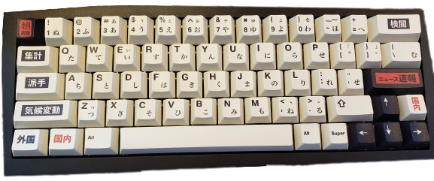
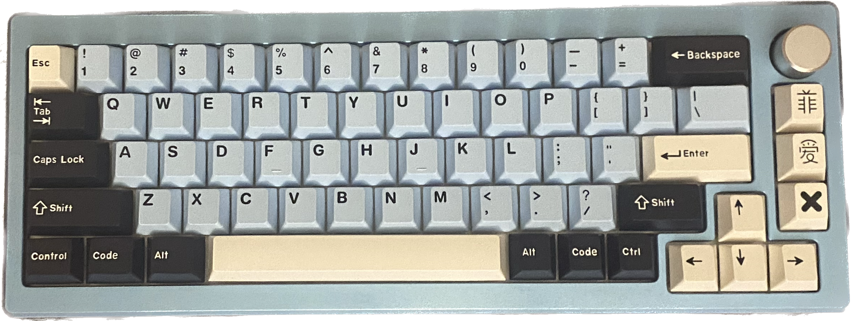
H0: μd= 0
HA: μd > 0
Alpha: 𝛂= 0.05
We will perform a paired t-test for μd, where μd represents mean difference (WPM of people typing on a Tactile keyboard - WPM of people who type on a Linear keyboard.)
Notes:
Alex

Slide 4
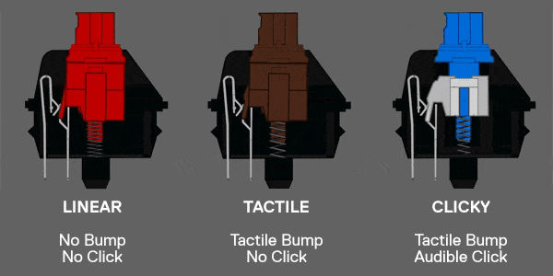
What are Switches??
Switches are the mechanism that you press on to actuate the command. (The things under the mechanical keyboard).
Three different types of switches, Linear, Tactile, and Clicky switches.
We will be testing 2 of the 3, Linear and Tactile.
Notes:
Alex

Slide 5
How are we conducting this Experiment?
Where/When?
Who?
01
02
What?
How are treatments assigned?
03
04
Japantown on May 16th, at 5:00 pm.
Randomly walk up to strangers and ask if they wanted to participate in our experiment.
We will have two keyboards, one with Linear and the other with Tactile switches.
We will flip a coin. If heads tactile first, if tails, linear first. After a 30 sec break, we will ask our subject to type on the other board.
Notes:
Wilson

Slide 6




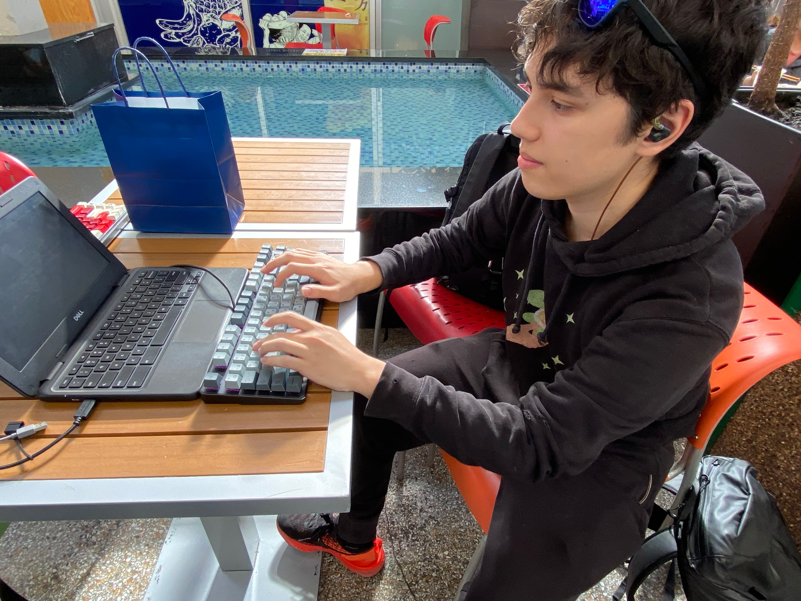

Data Collection!!
Notes:
Alex

Slide 7


Data Collection!! (Continued…)
Fellow Keyboard Enthusiast :0
Video of a test subject :D
Notes:
Alex

Slide 8
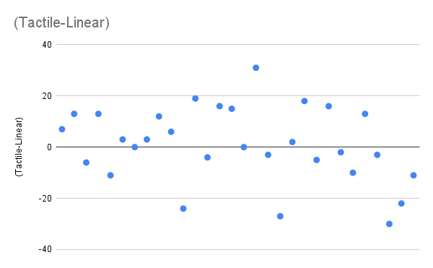
Graphs and Summary Statistics
Scatterplot
Notes:
Alex

Slide 9
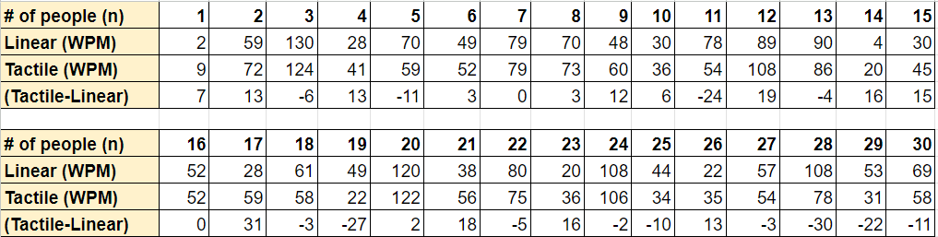
Graphs and Summary Statistics
Table
Notes:
Alex

Slide 10
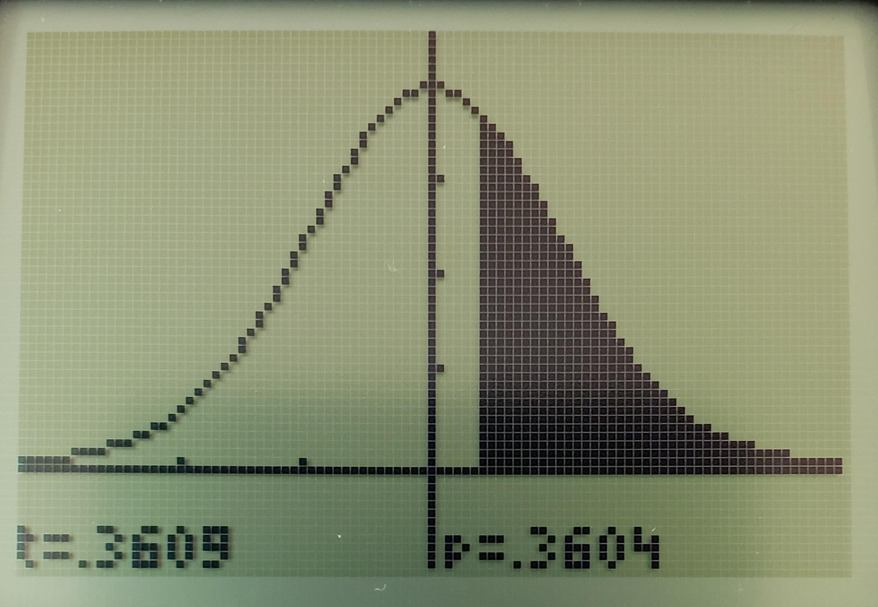
Analysis
We will perform a paired t-test μ difference if conditions are met.
Conditions:
Random: Random assignment and Random Sample.
10%: We can safely assume there were at least (30 x 10) 300 people at
Japantown.
CLT: Because we obtained a random sample of at least 30, it’s safe to assume this data is approximately normal.
P-value= 0.3604 t= 0.3609
Sx= 14.6722
X̄= 0.9667 n= 30
Notes:
Wilson

Slide 11

Conclusion
Because our P-value of (0.3604) is greater than ∝=0.05, we fail to reject the null hypothesis. We do not have convincing evidence that typing on Tactile switches is better than Linear switches on a mechanical keyboard.
Notes:
Alex

Slide 12
Possible errors/Limitations:
Both keyboards vary in size. However, we attempted to control this by having similar quality switches and key caps to account for this.
Not all tests are created equally; some typing tests had more difficult words than others, however we controlled this because all tests are randomized through the website (Monkeytype).
We had a participant who used a different typing layout called Colemak instead of QWERTY. By keeping all of our test on QWERTY we were able keep our testing consistent
Notes:
Wilson

Slide 13


Thanks for Listening!
Notes:
Both

